Slide 1

Engineering Graphics
ME 2000
Isometric Projections
Dr. Vikash Kumar

Slide 2
Introduction
Display all the three dimensions of an object in one view
Isometric projection
All the views have to be read simultaneously and a conclusion to be drawn mentally
Orthographic projection
To distinguish Isometric Projection from Orthographic projections , use CAPITAL LETTERS for the corners
Rule

Slide 3
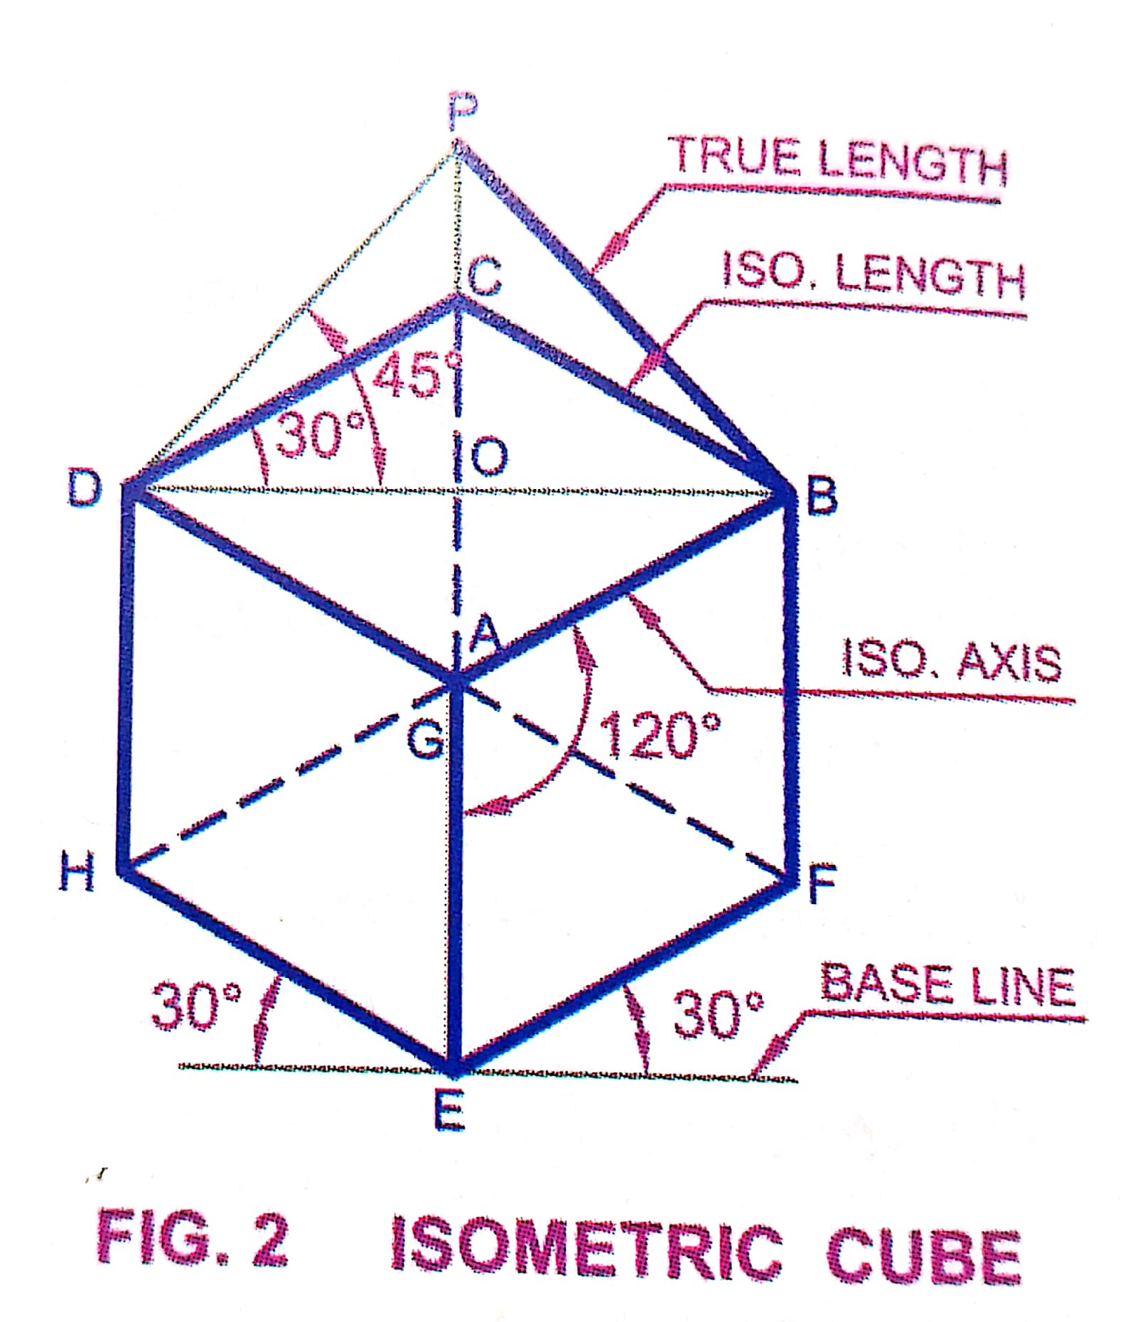
Terminology
Isometric Axes
Lines AB, AD and AE meeting at a point A and making an angle of 120°.
Isometric Lines
Lines parallel to the isometric axes are termed as isometric lines (CD, CB, etc.).
Non-Isometric Lines
Lines not parallel to the isometric axes are termed as non-isometric lines. Line BD is an example.

Slide 4
Terminology
Isometric Planes
Planes representing the faces of cube as well as other planes parallel to these planes are termed as Isometric planes
There are three isometric planes (Left Isometric plane, Right Isometric plane and Top Isometric plane) containing any two isometric axis.
Note
Non-Isometric Planes
Planes not parallel to isometric planes are Non-Isometric planes

Slide 5
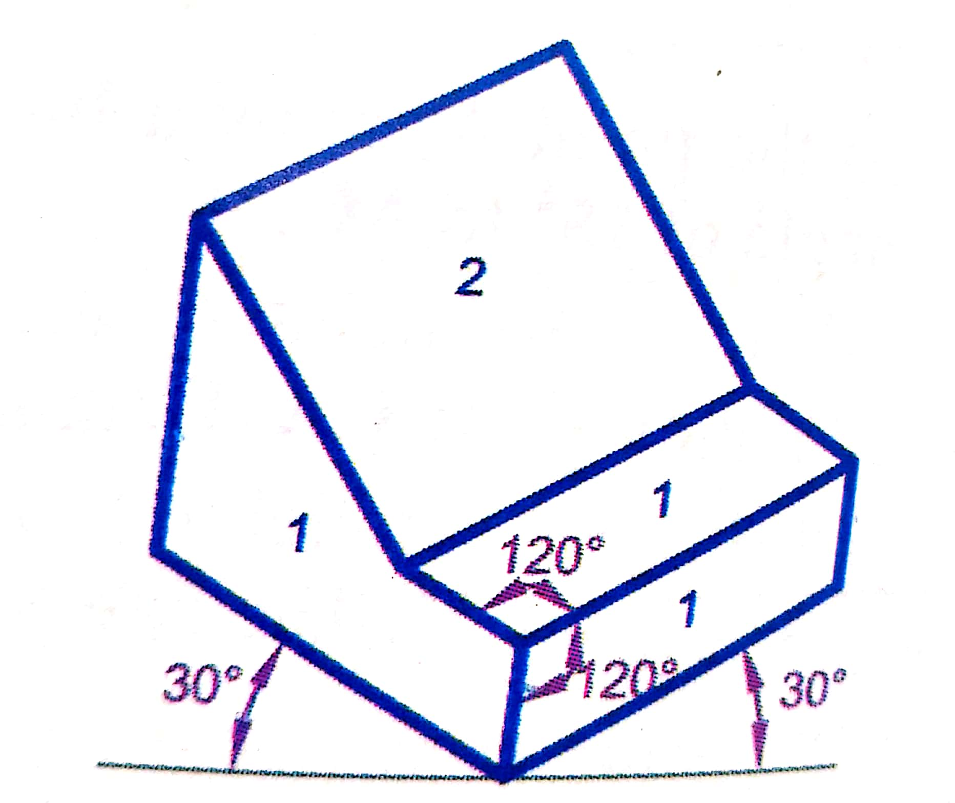
Terminology
Non-Isometric plane
Isometric plane

Slide 6
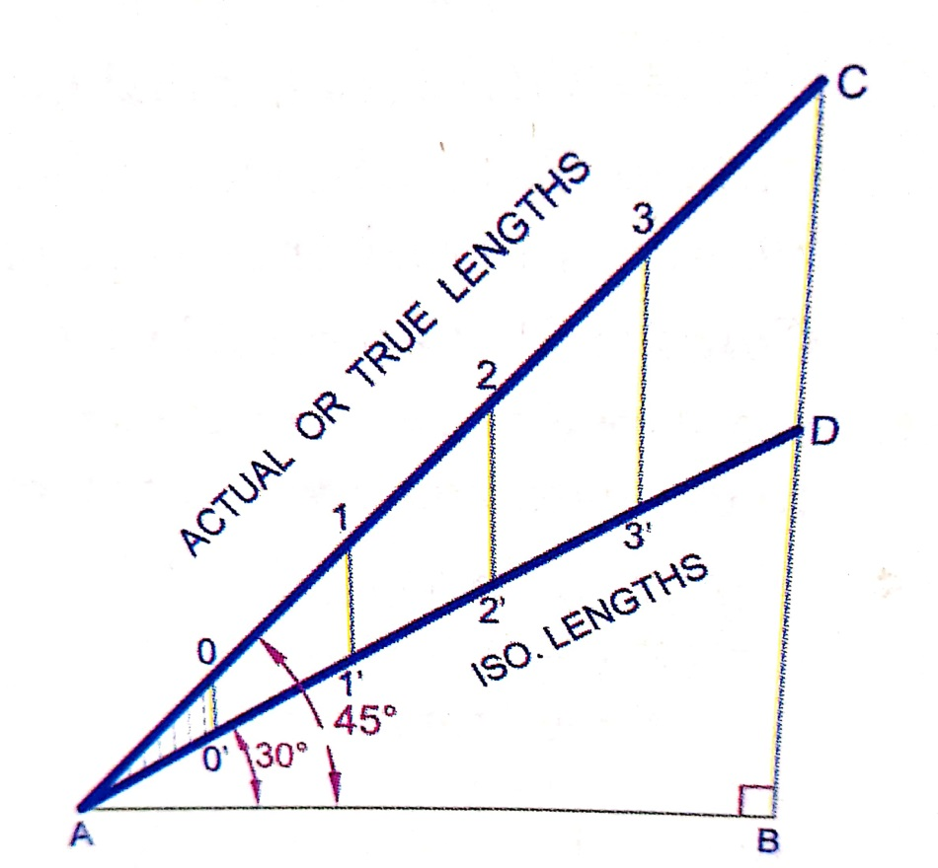
Isometric Scale - construction
Isometric Scale
Isometric projection is drawn using Isometric scale, which convert true lengths into isometric lengths which are foreshortened.
In Isometric projection
Isometric length = 0.82 * Actual length
Along the direction of 3 isometric axes
Isometric scale

Slide 7
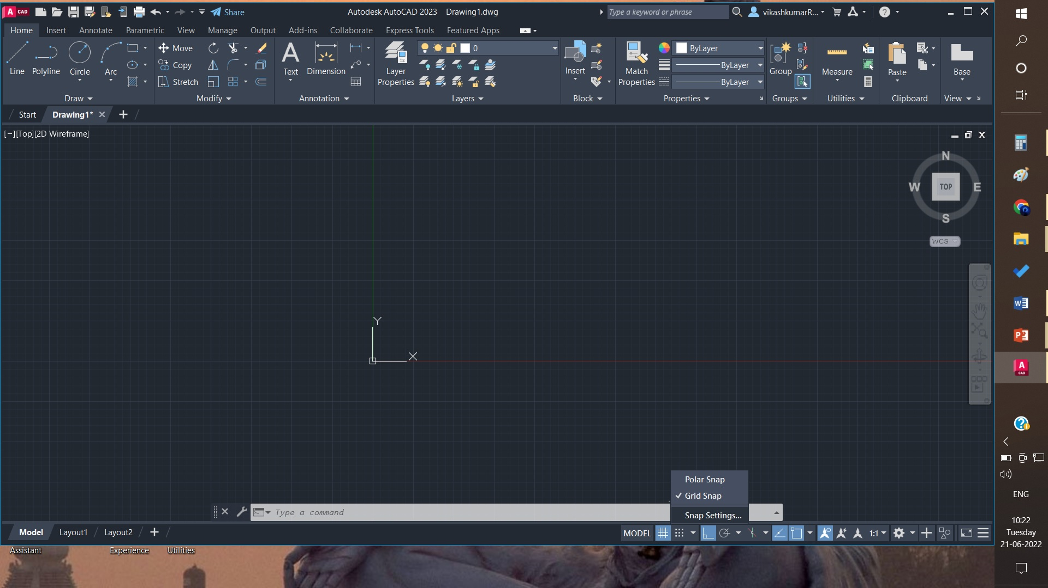

Slide 8
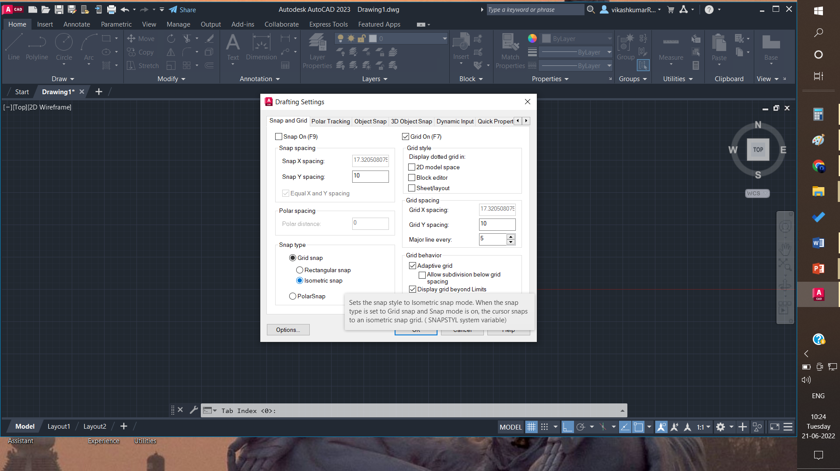

Slide 9
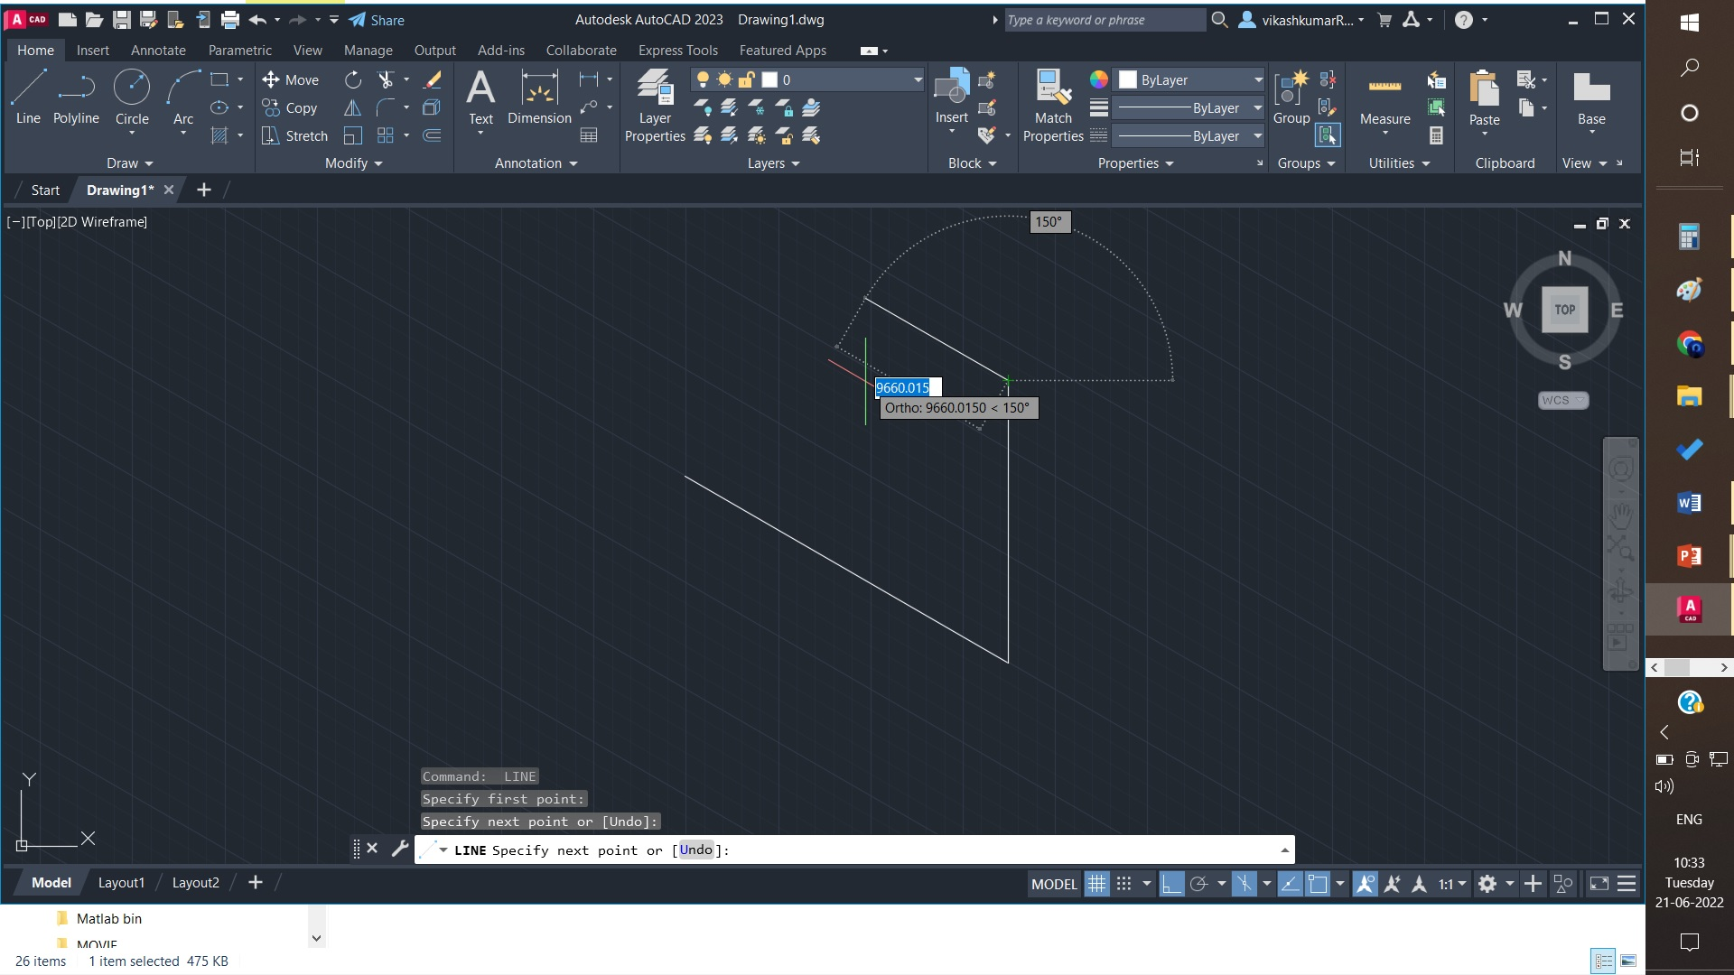

Slide 10
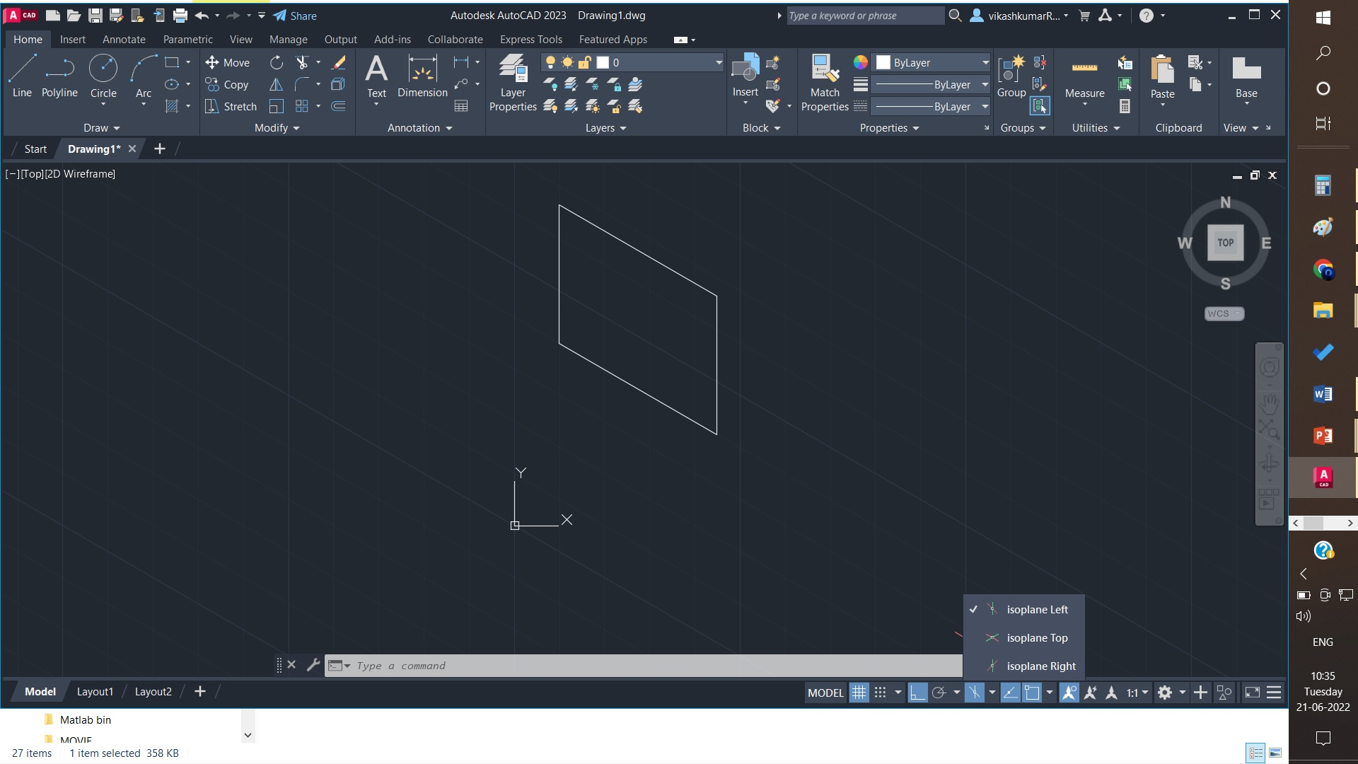

Slide 11
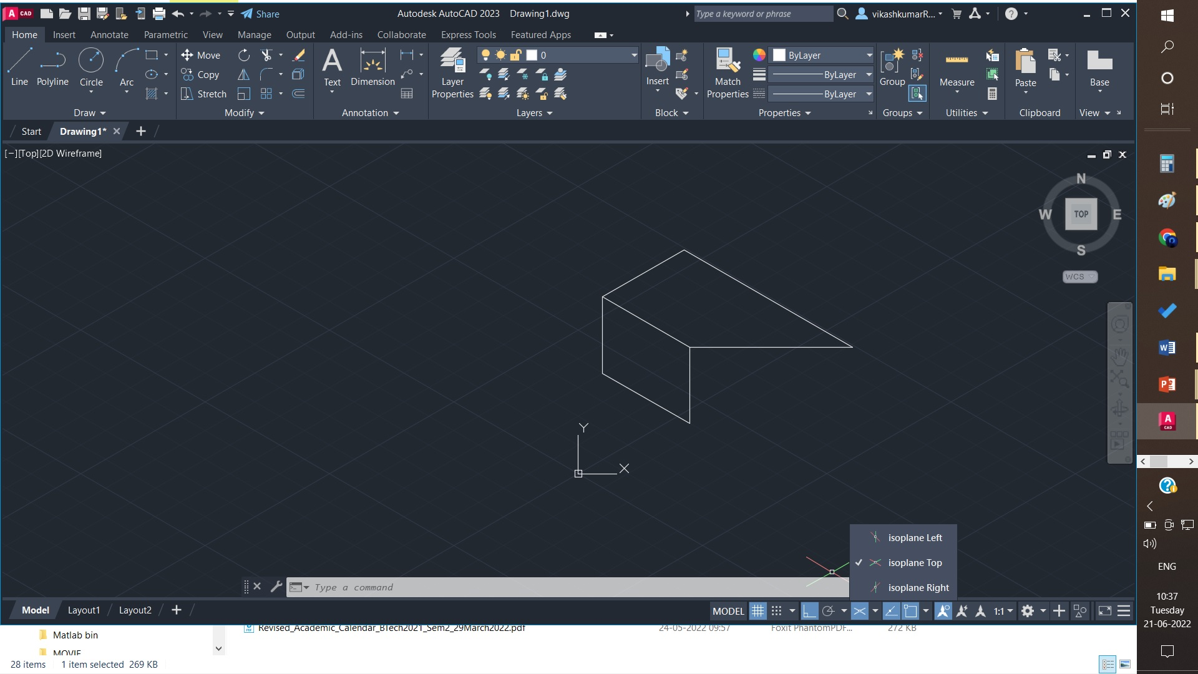

Slide 12
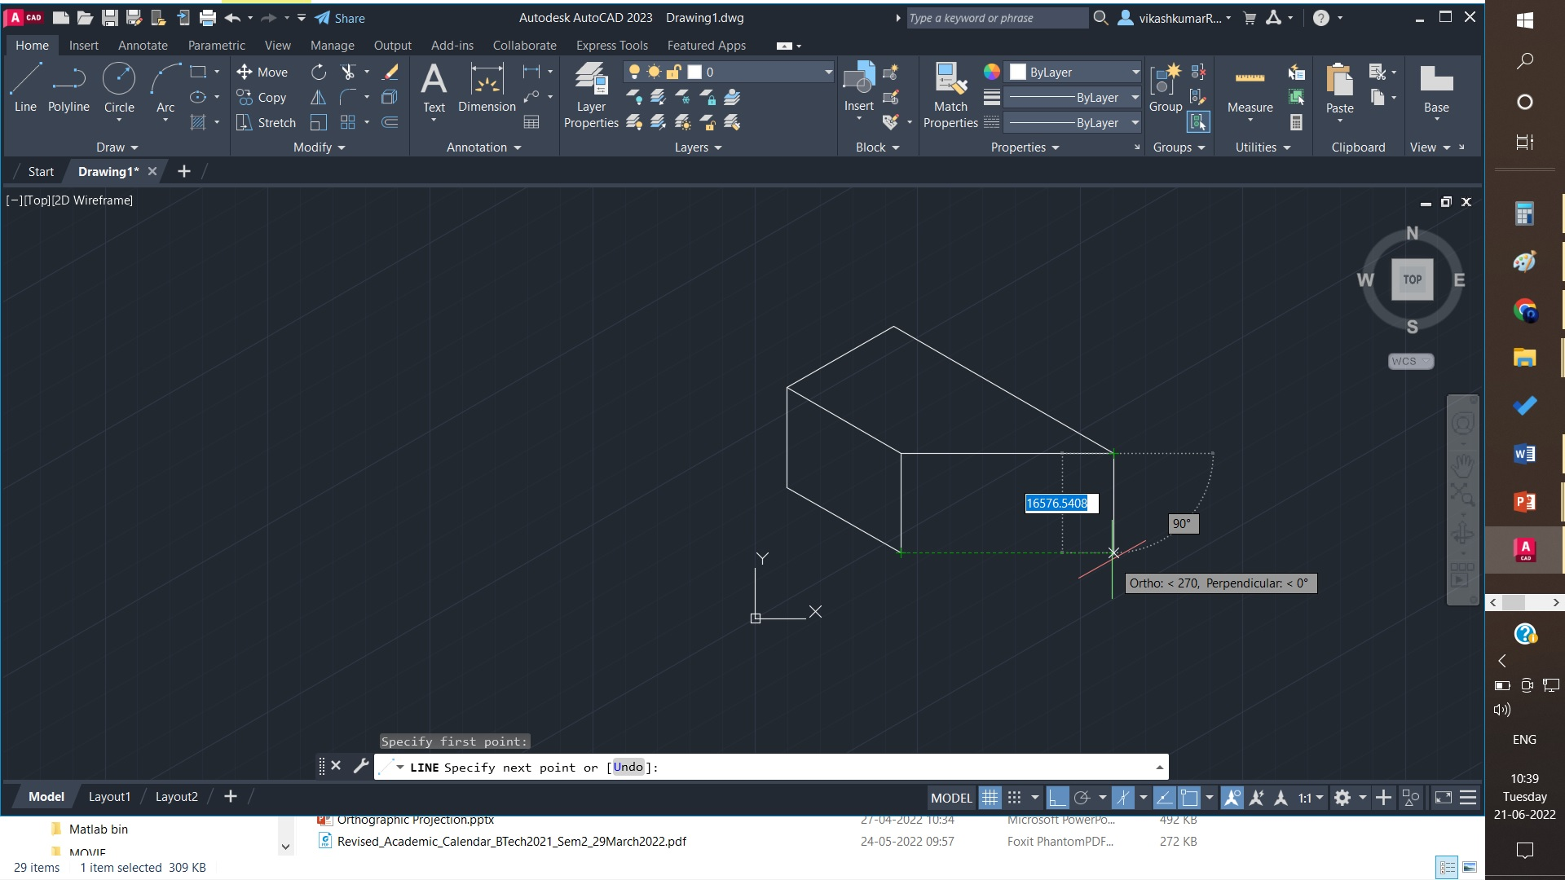

Slide 13
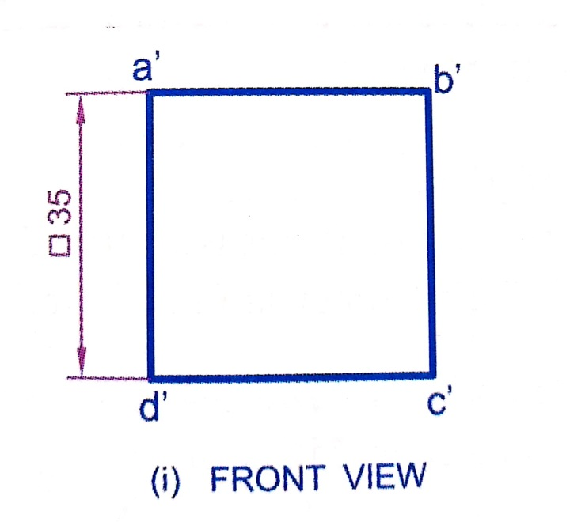
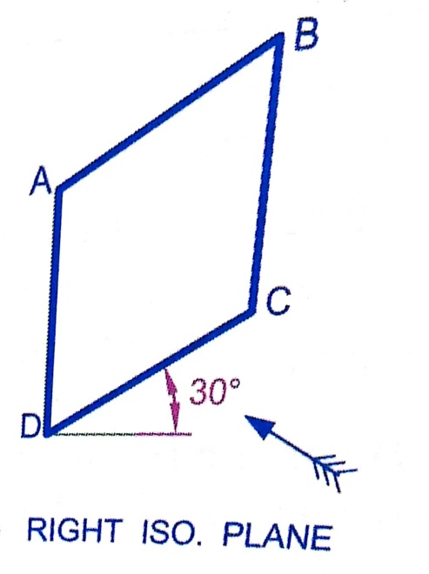
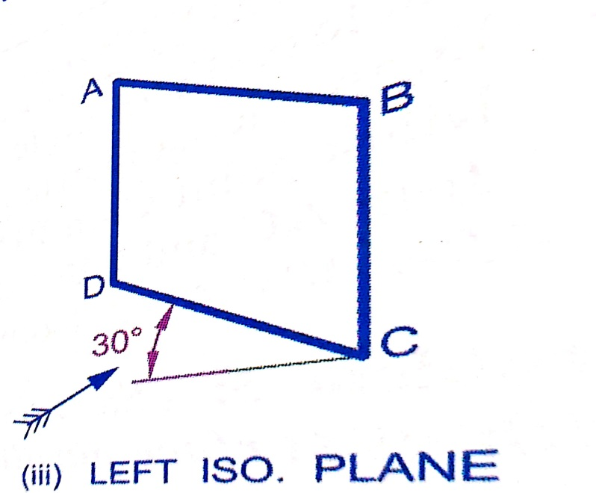
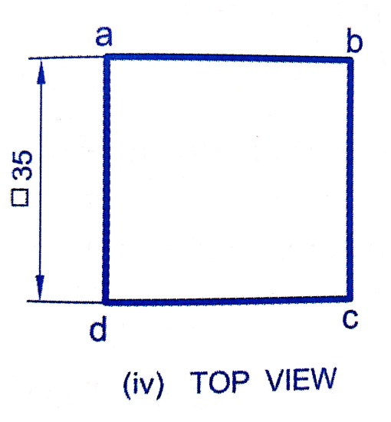
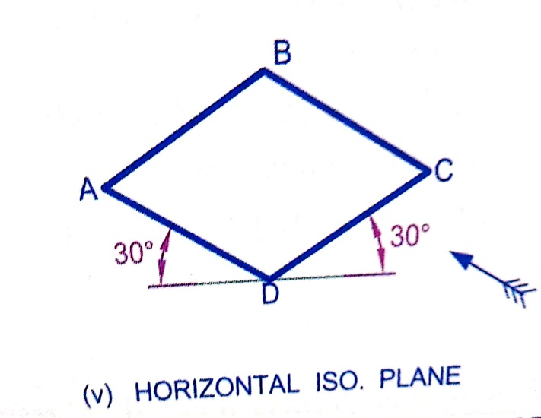
Isometric Projections
Draw the isometric projection of a square lamina of side 35 mm when it is placed with its surface (a) vertical and (b) horizontal.
Front View
Right ISO. plane
Left ISO. plane
Top View
Horizontal ISO. plane

Slide 14
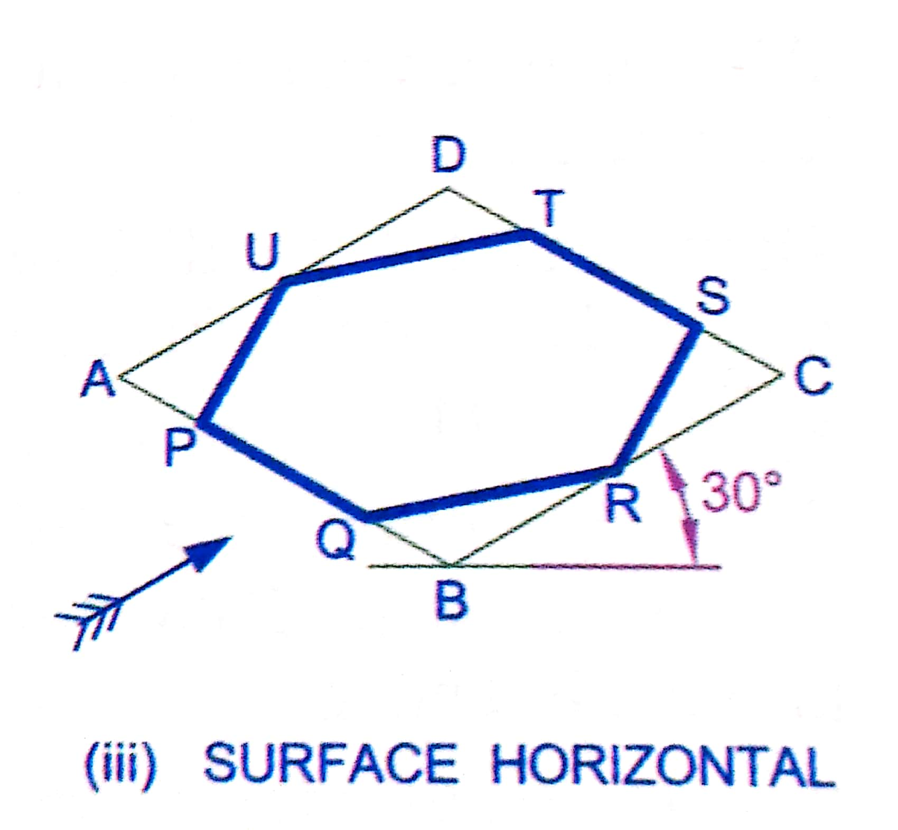
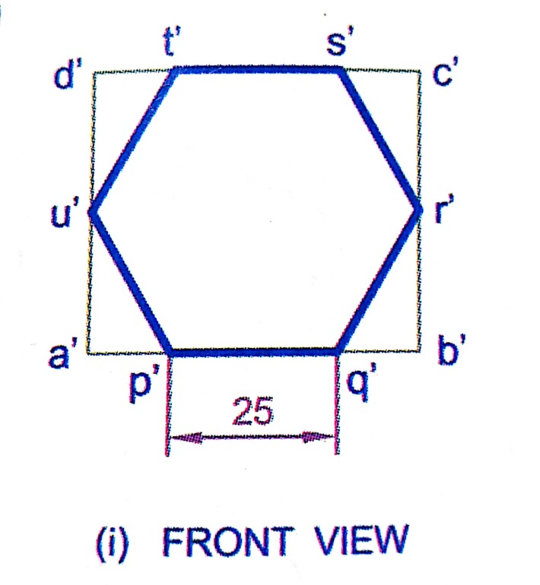
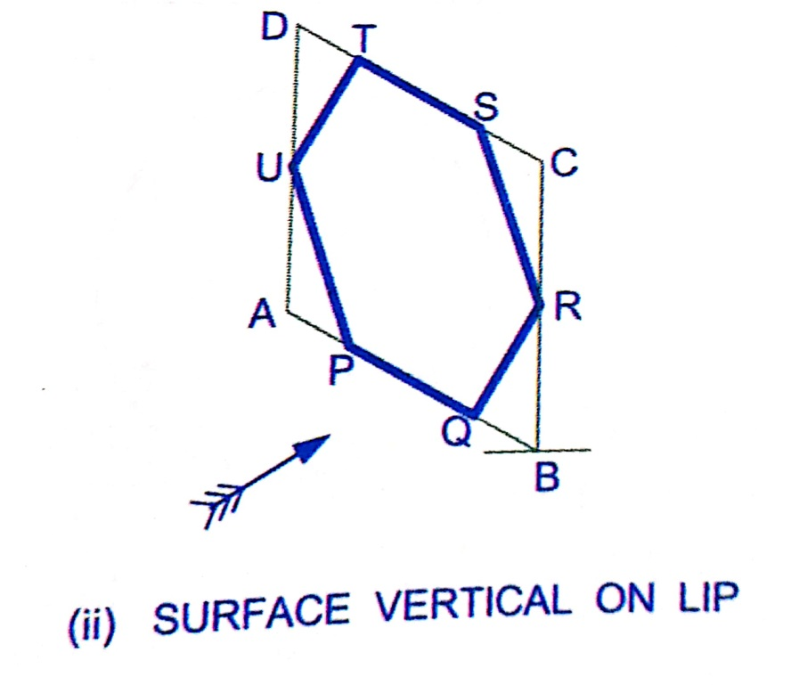
Isometric Projections
Draw the isometric projection of a regular hexagon of 25 mm when it is placed with its surface (a) vertical and (b) horizontal.
Horizontal surface
Vertical surface
Front View

Slide 15
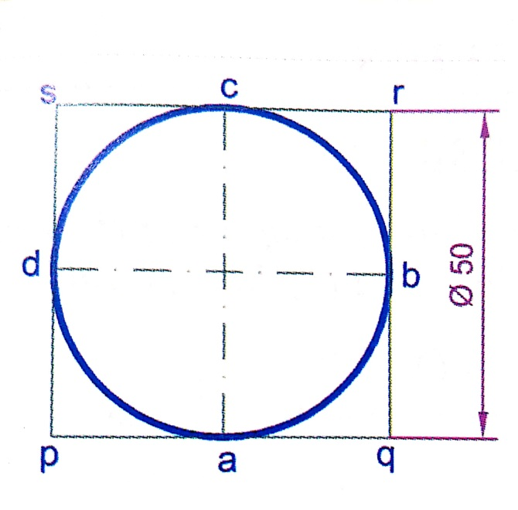
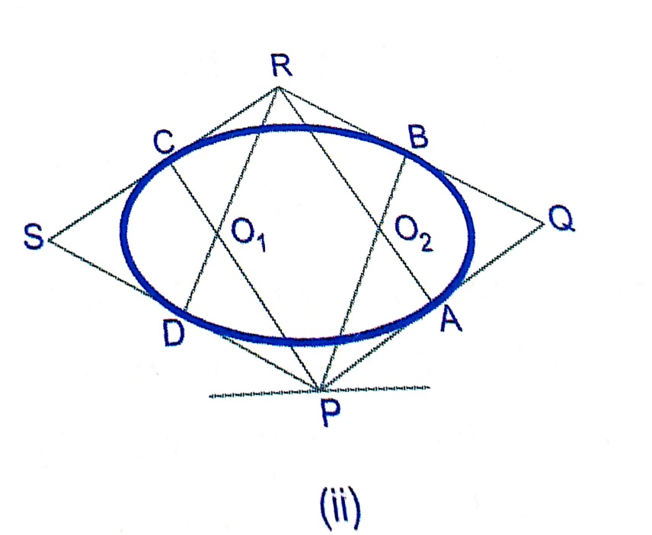
Isometric Projections
Draw the isometric projection of a circle with its surface parallel to HP.
S
Four center method
Draw isometric projection of square pqrs as rhombus PQRS in isometric scale.
Mark mid point of PQ, QR, RS and SP as A, B, C, and D respectively.
Join P with B and C
Join R with A and D
P as center and PC as radius draw an arc CB
R as center and RA as radius draw an arc AD
PC and RD cut at O1. O1 as center and O1D as radius draw and arc DC.
Similarly O2 as center and O2B as radius draw and arc BA.

Slide 16
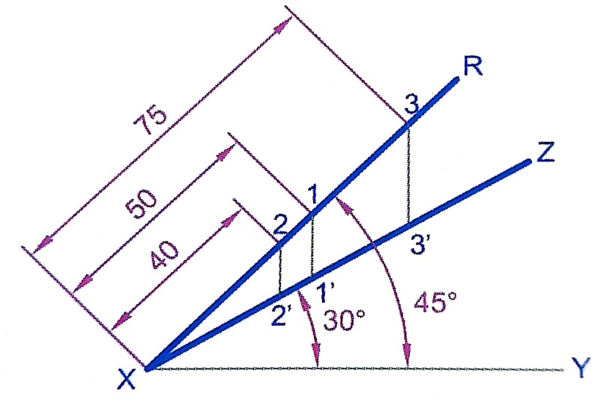
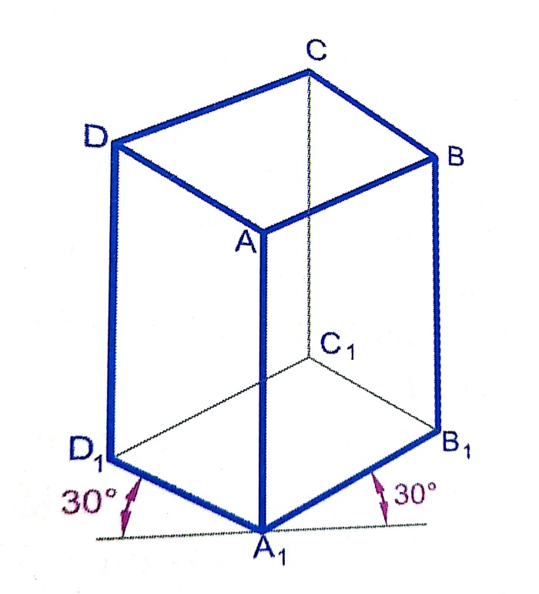
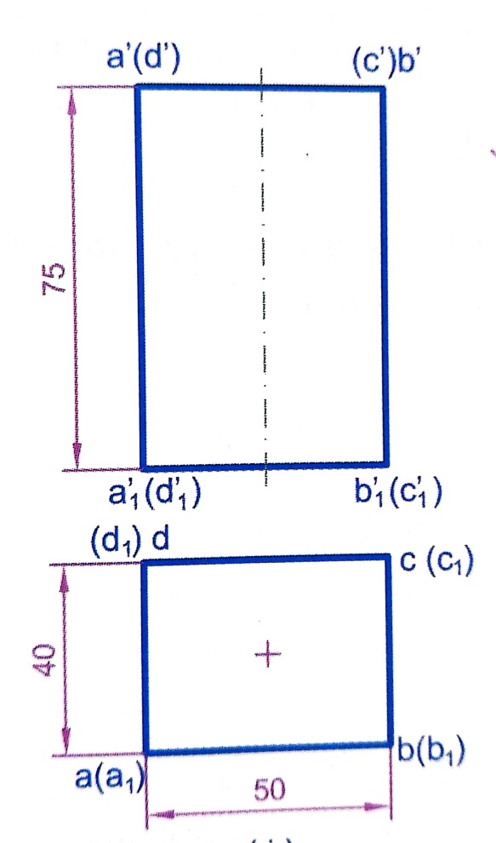
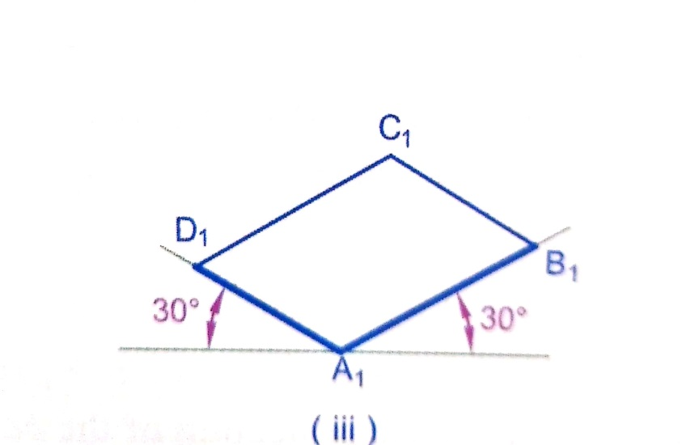
Isometric Projections
Draw the isometric projection of a rectangular prism of base 50 mm x 40 mm and height 75 mm. when rests with base on HP and one of its rectangular faces is parallel to VP.
Isometric scale
Base

Slide 17
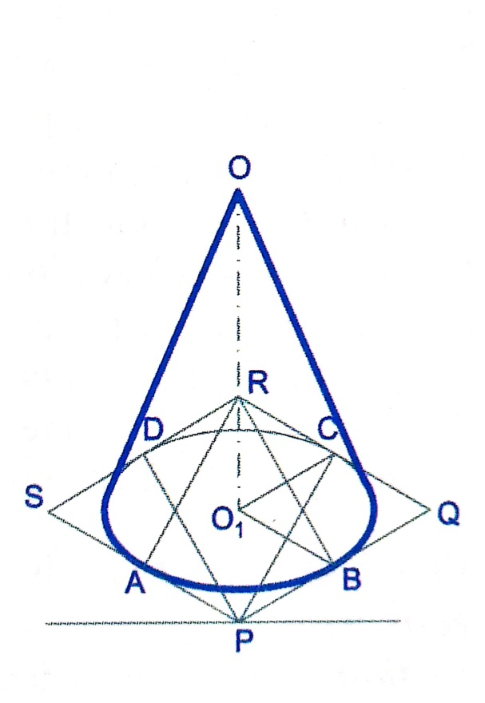
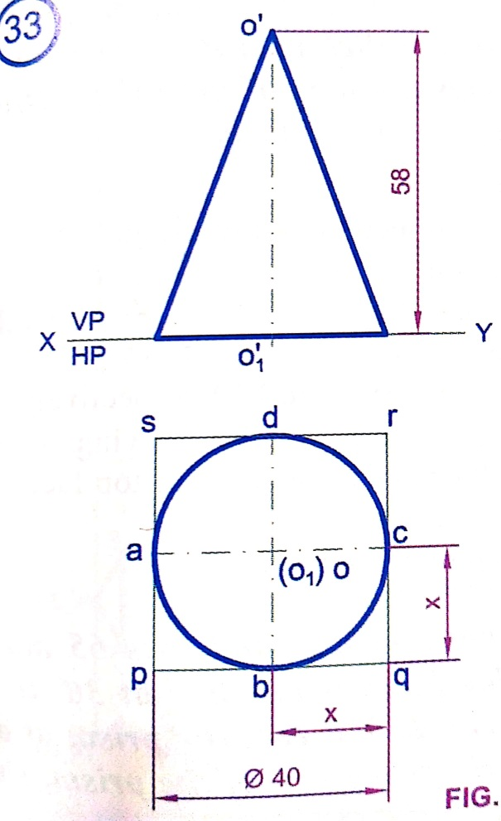
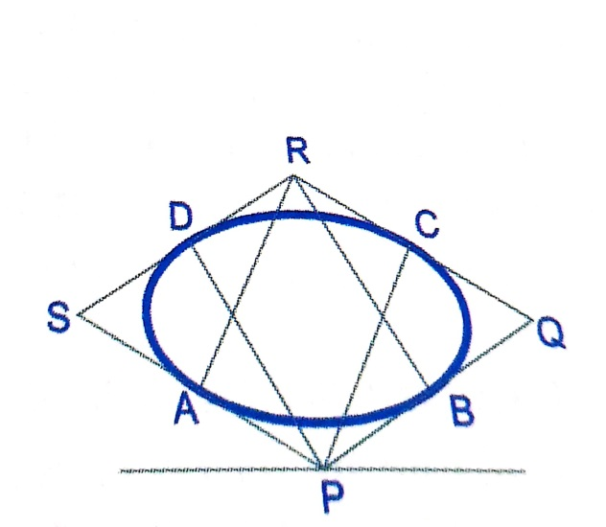
Isometric Projections
Draw the isometric projection of a cone of base 40 mm diameter and height 58 mm when it rests with its base on HP.
Isometric projection
Base circle

Slide 18
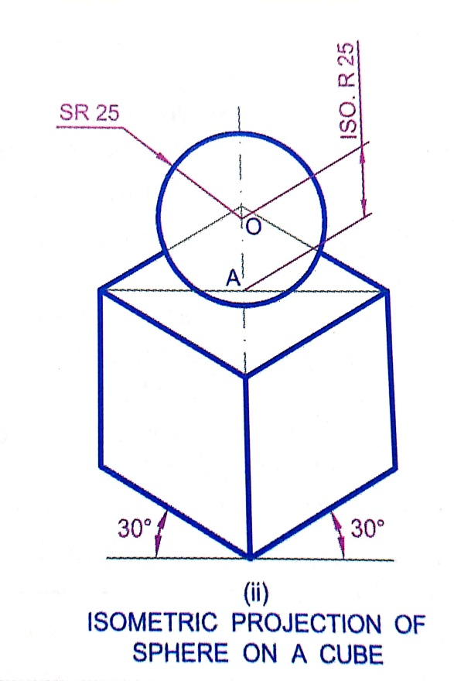
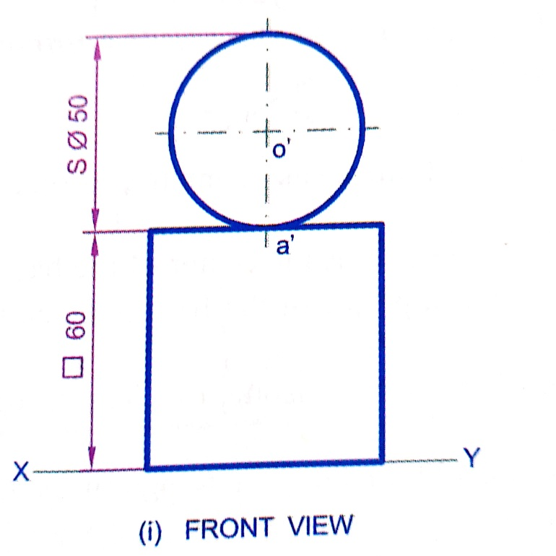
Isometric Projections
Draw the isometric projection of a sphere of diameter 50 mm resting centrally on the top of a cube of side 60 mm.
Draw isometric projection of square block in isometric scale.
Locate the center A of the block.
Draw a vertical at A. Mark point O on it such that AO= Isometric radius of sphere.
O as center and radius equal to true radius of the sphere, draw a circle which is isometric projection of the sphere.

Slide 19
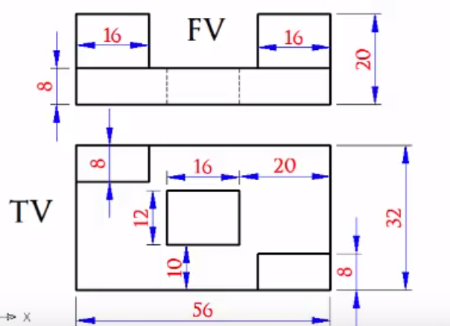
Conversion of orthographic view to Isometric view
Draw the Isometric view for engineering component given in Figure below:

Slide 20
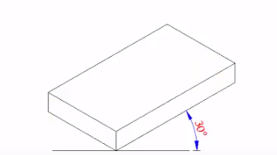
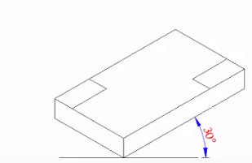
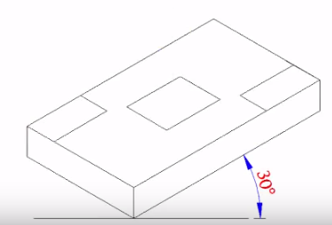
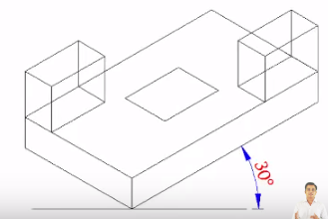
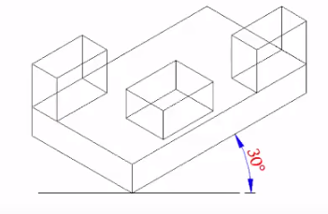
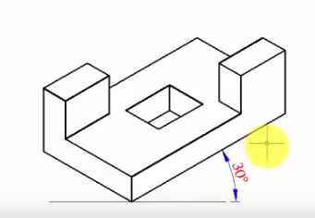
Conversion of orthographic view to Isometric view
Step 1
Step 2
Step 3
Step 4
Step 5
Step 6

Slide 21
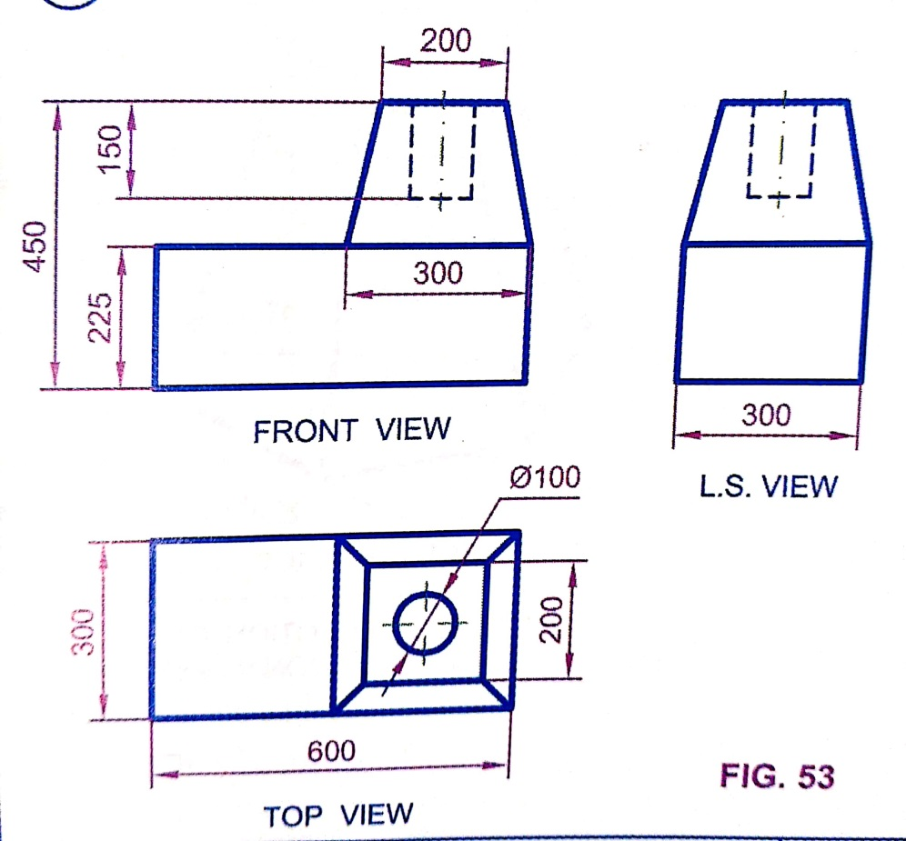
Conversion of orthographic view to Isometric view
Draw the Isometric view for MIXIE BASE given in Figure below:
300

Slide 22
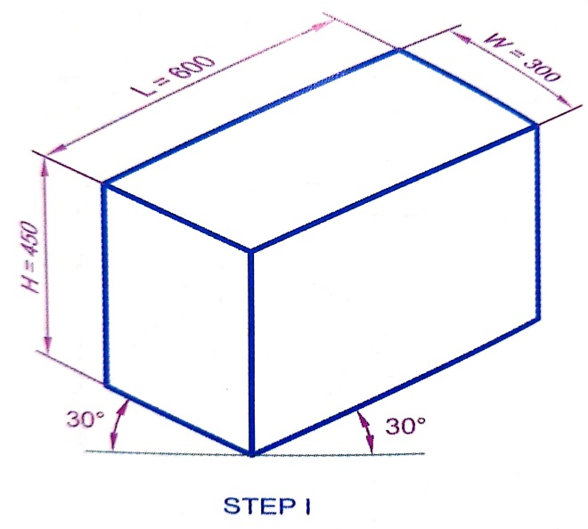
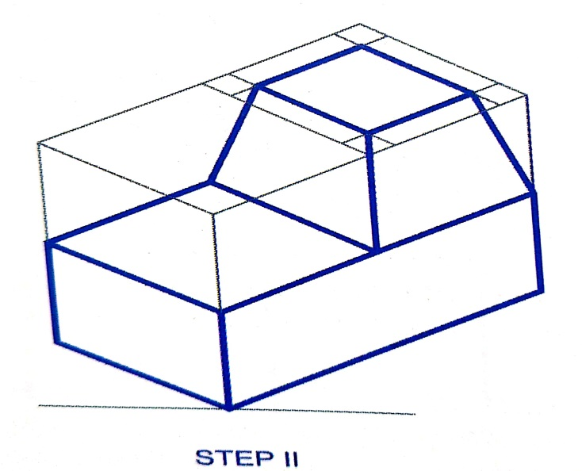
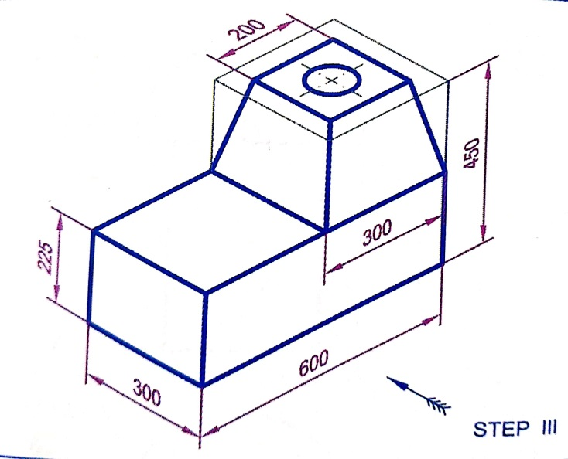
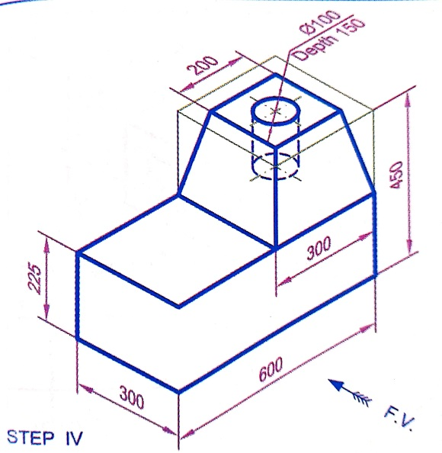
Conversion of orthographic view to Isometric view
Draw the Isometric view for MIXIE BASE given in Figure below:

Slide 23
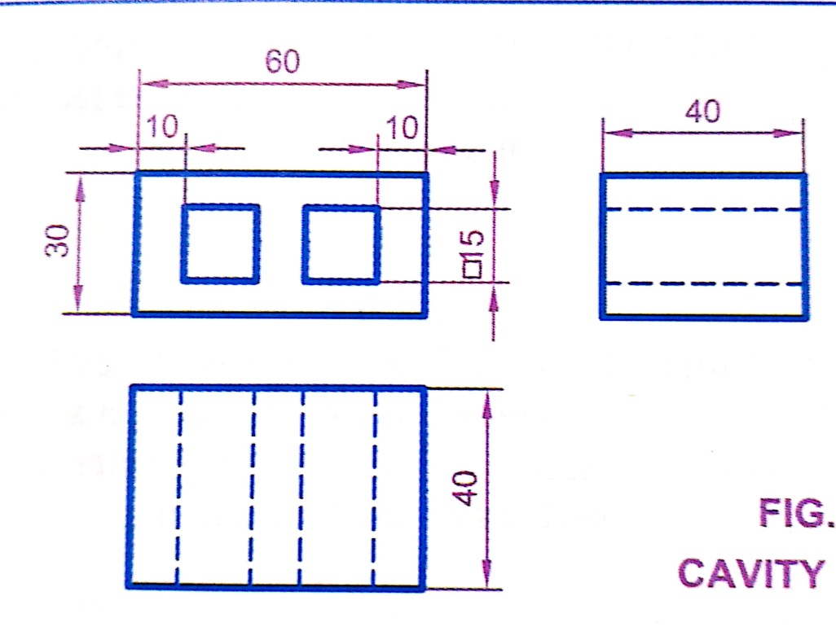
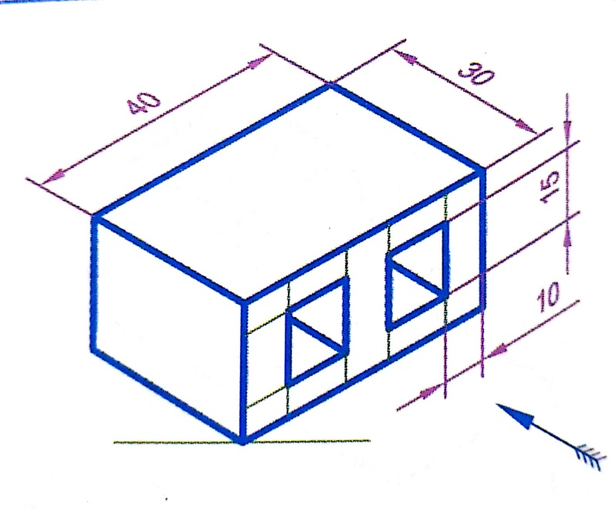
Conversion of orthographic view to Isometric view
Draw the Isometric view for Engineering component given in Figure below:

Slide 24
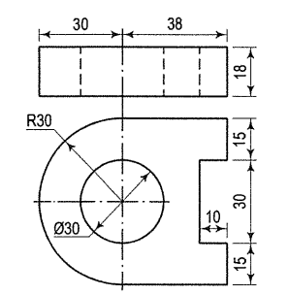
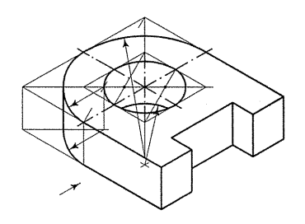
Conversion of orthographic view to Isometric view
Draw the Isometric view for Engineering component given in Figure below:

Slide 25
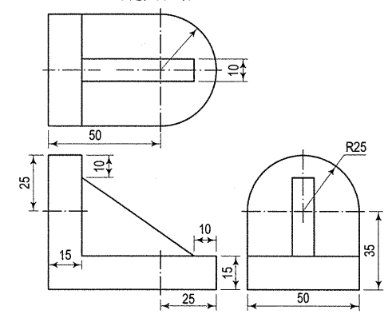
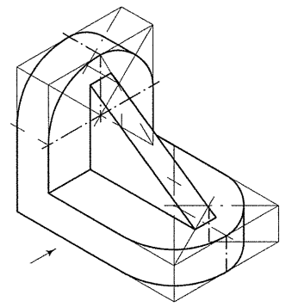
Conversion of orthographic view to Isometric view
Draw the Isometric view for Engineering component given in Figure below:

Slide 26
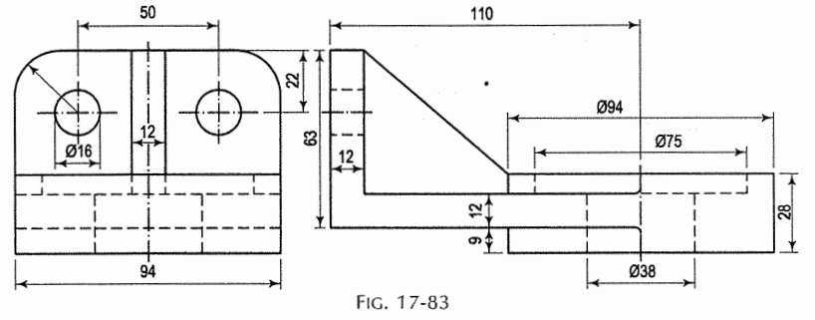
Conversion of orthographic view to Isometric view
Draw the Isometric view for Engineering component given in Figure below:

Slide 27
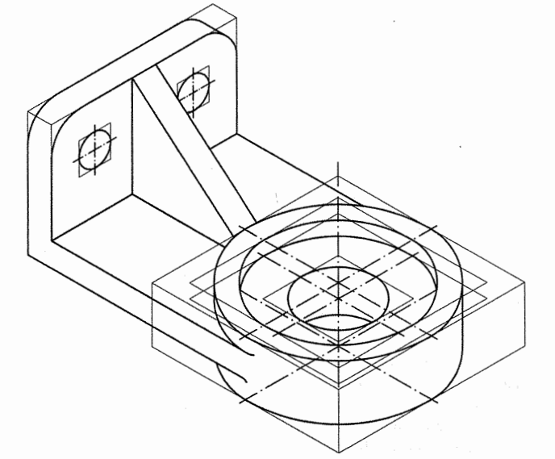
Conversion of orthographic view to Isometric view
Draw the Isometric view for Engineering component given in Figure below:

Slide 28
Thank You

